Slide 1
Cog*ify
BWSI Cog*Works 2023
By: Rohan Dugad, Medha Mittal, Khoi Nguyen, Aadi Shah, Aswin Surya, and Pyae Sone Hmine (TA)
Notes:
Hi everyone, we are the developers of project Cog*Ify.
I am Rohan Dugad from Basking Ridge, New Jersey
I am Medha Mittal from Sammamish, Washington.
I am Khoi Nguyen from Northern Virginia
I am Aadi Shah from Sunnyvale, California
I am Aswin Surya from San Jose, California.
We are students of BWSI’s CogWorks 2023.

Slide 2



Problem
Maintain excitement with high energy music
Spend more time with your friends
OR
Which do you choose?
Notes:
Imagine you have your friends over, and you want to kick off the party. You decide to play music
[Click for Slide Animation]
but you want to spend time with your friends, too.
[Click for Slide Animation]
So how do you keep the music going? Do you hire a DJ?
[Click for Slide Animation]
Can you afford to, every time your friends come over?

Slide 3


No DJ? No problem!
Notes:
Have no fear: with Cog*Ify, no DJ is no problem! In making Cog*Ify, we hoped to create an AI music mixer that maintains the excitement of a party by mixing the most high energy segments of songs together, because no person should!

Slide 4
01
02
03
Deployment pipeline
Training pipeline
Demo
04
05
Music Video Generation
Future improvements
The creation of Cog*Ify
Cog*Ify in action
Good ol’ machine learning
Diffusion models!
Cog*Ify 2.0?
Notes:
Before we start, we’ll discuss what we hope to cover today. We’ll cover our deployment process and demo, before discussing our model’s training pipeline and the challenges we faced. Then, we’ll take a look at how we generated a music video for our remixed playlist. Finally, we’ll discuss any future improvements that we could make in Cog*Ify 2.0.

Slide 5
Deployment pipeline
How does the program work?
Notes:
But how exactly does Cog*Ify work? How can people use it?

Slide 6
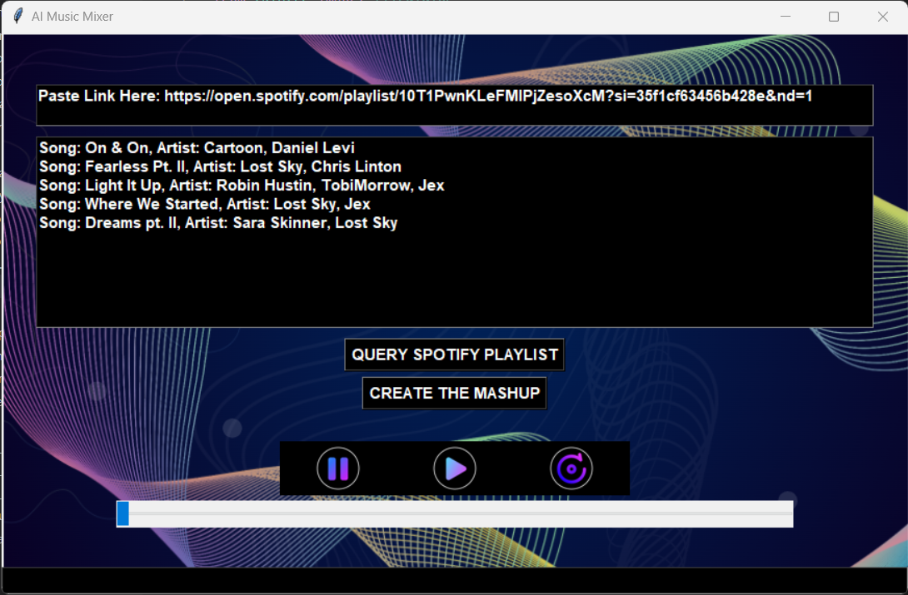
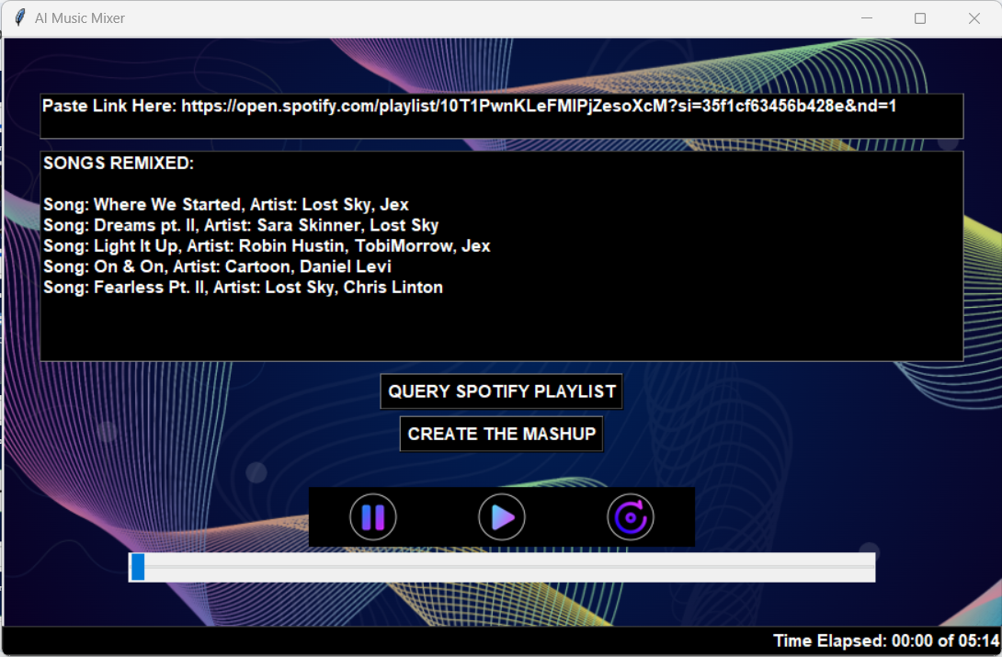
Graphical user interface
Input the Spotify playlist link
Query Spotify Playlist
Create the Mashup
Song order is updated
Notes:
Our program starts with a graphical user interface
[Click for Slide Animation]
where the user can paste the url link to their spotify playlist at the very top.
[Click for Slide Animation]
From there, they can generate their mashup by clicking the query spotify playlist button
[Click for Slide Animation]
and then clicking create the mashup.
The song titles and artist names will be displayed in the bottom box of the GUI in the same order as the spotify playlist,
[Click for Slide Animation]
and this order will be updated after the mashup is created to show the song order in the mashup.

Slide 7
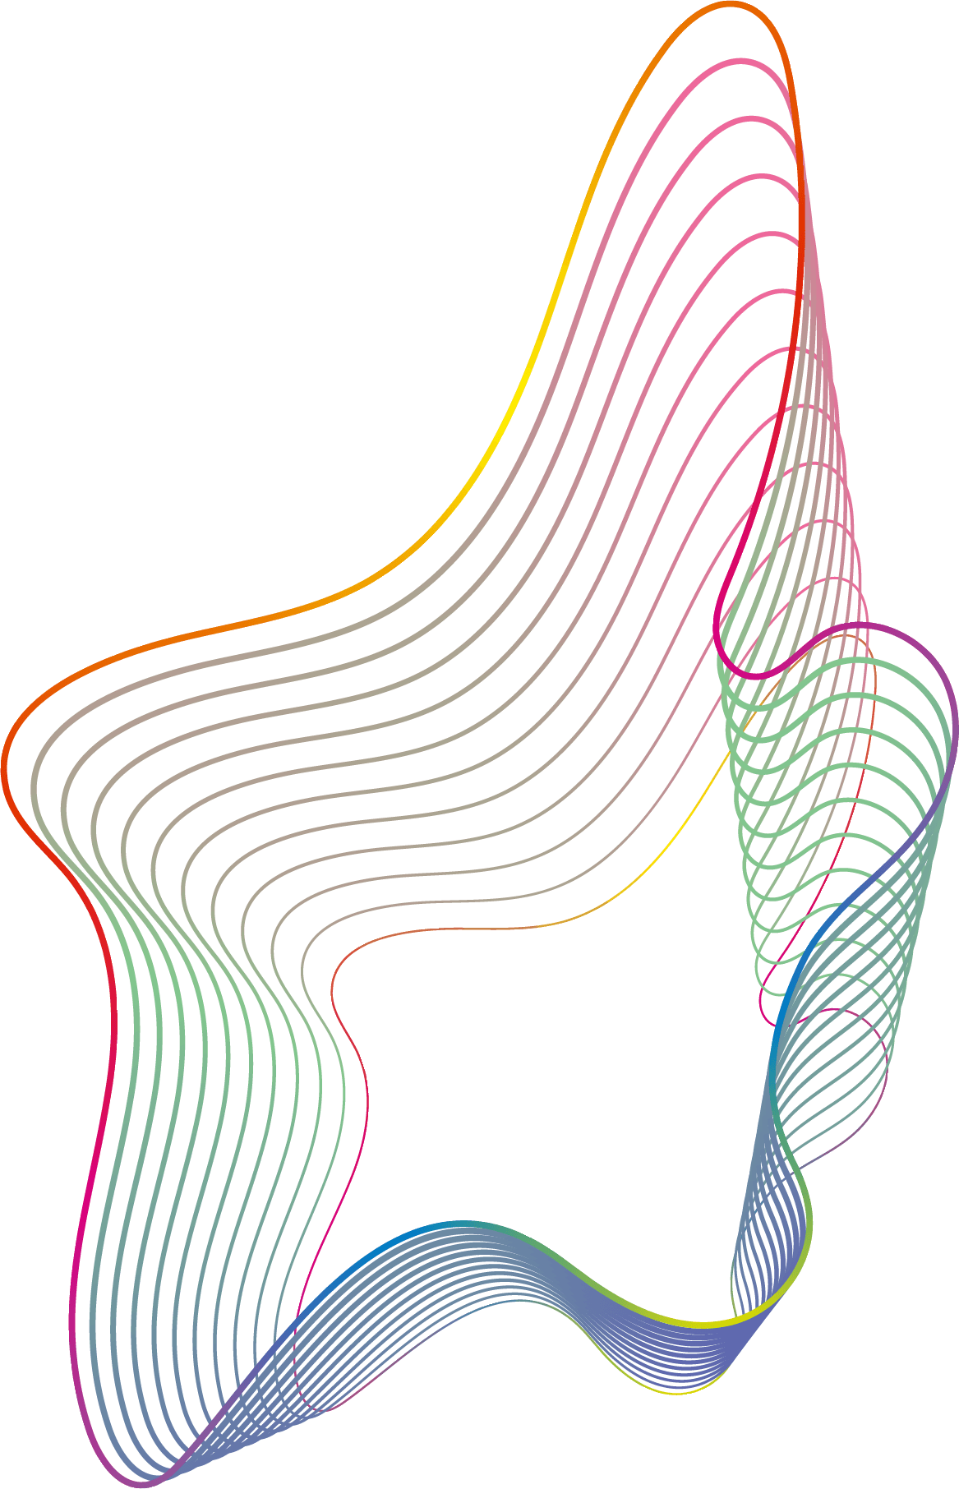
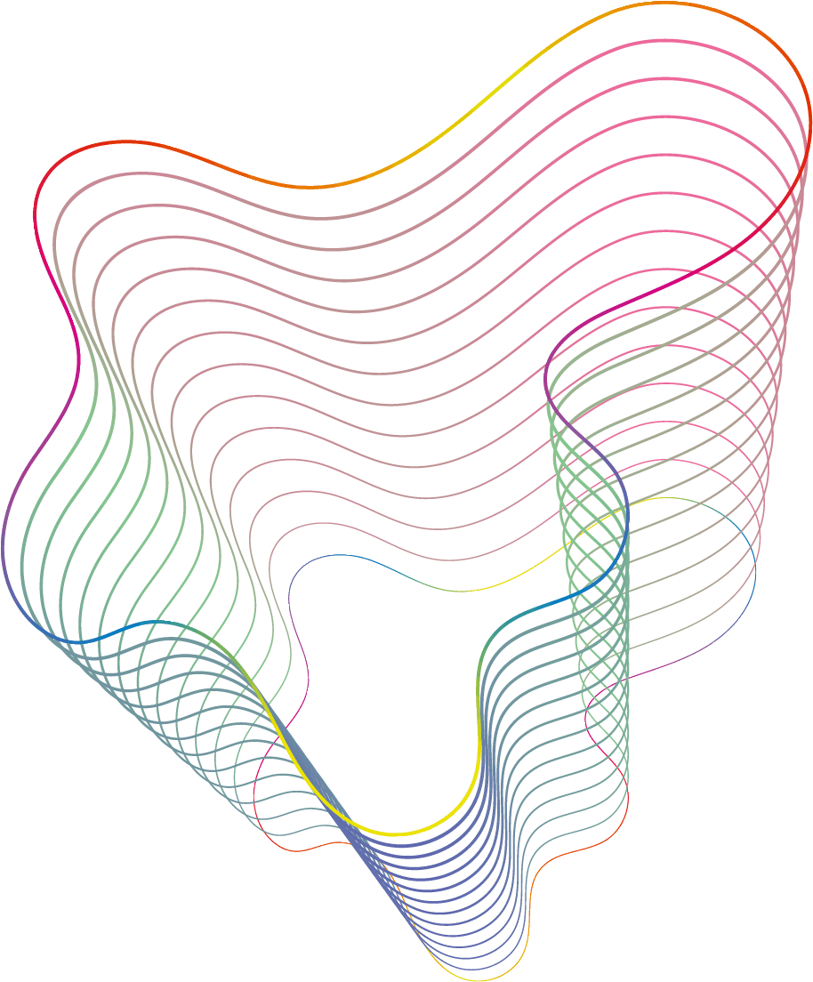
Getting (NCS) Song data
Spotify API
Youtube API
Scraping song data
ClippinG Songs
Use Spotify’s built in API to get the song names and artists in a playlist
Use Youtube’s search api to get videos of the songs from the spotify playlist
Scrape the song metadata from YouTube
Send the data to the model to get timestamps and then clip the songs
Notes:
Our program takes the user’s playlist link and uses spotify’s official API to fetch the song names and artists for the songs in the playlist. Then, using the YouTube API we get the top search result for the song name and artist name, and then we scrape the song data if it is a no copyright song. Next, the model, using the song data, predicts the best part of the song and the program splices together a mashup of the best song parts.

Slide 8
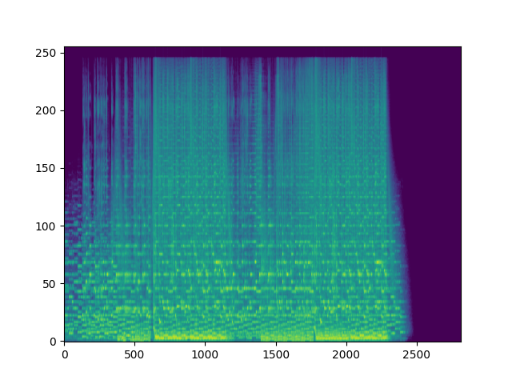
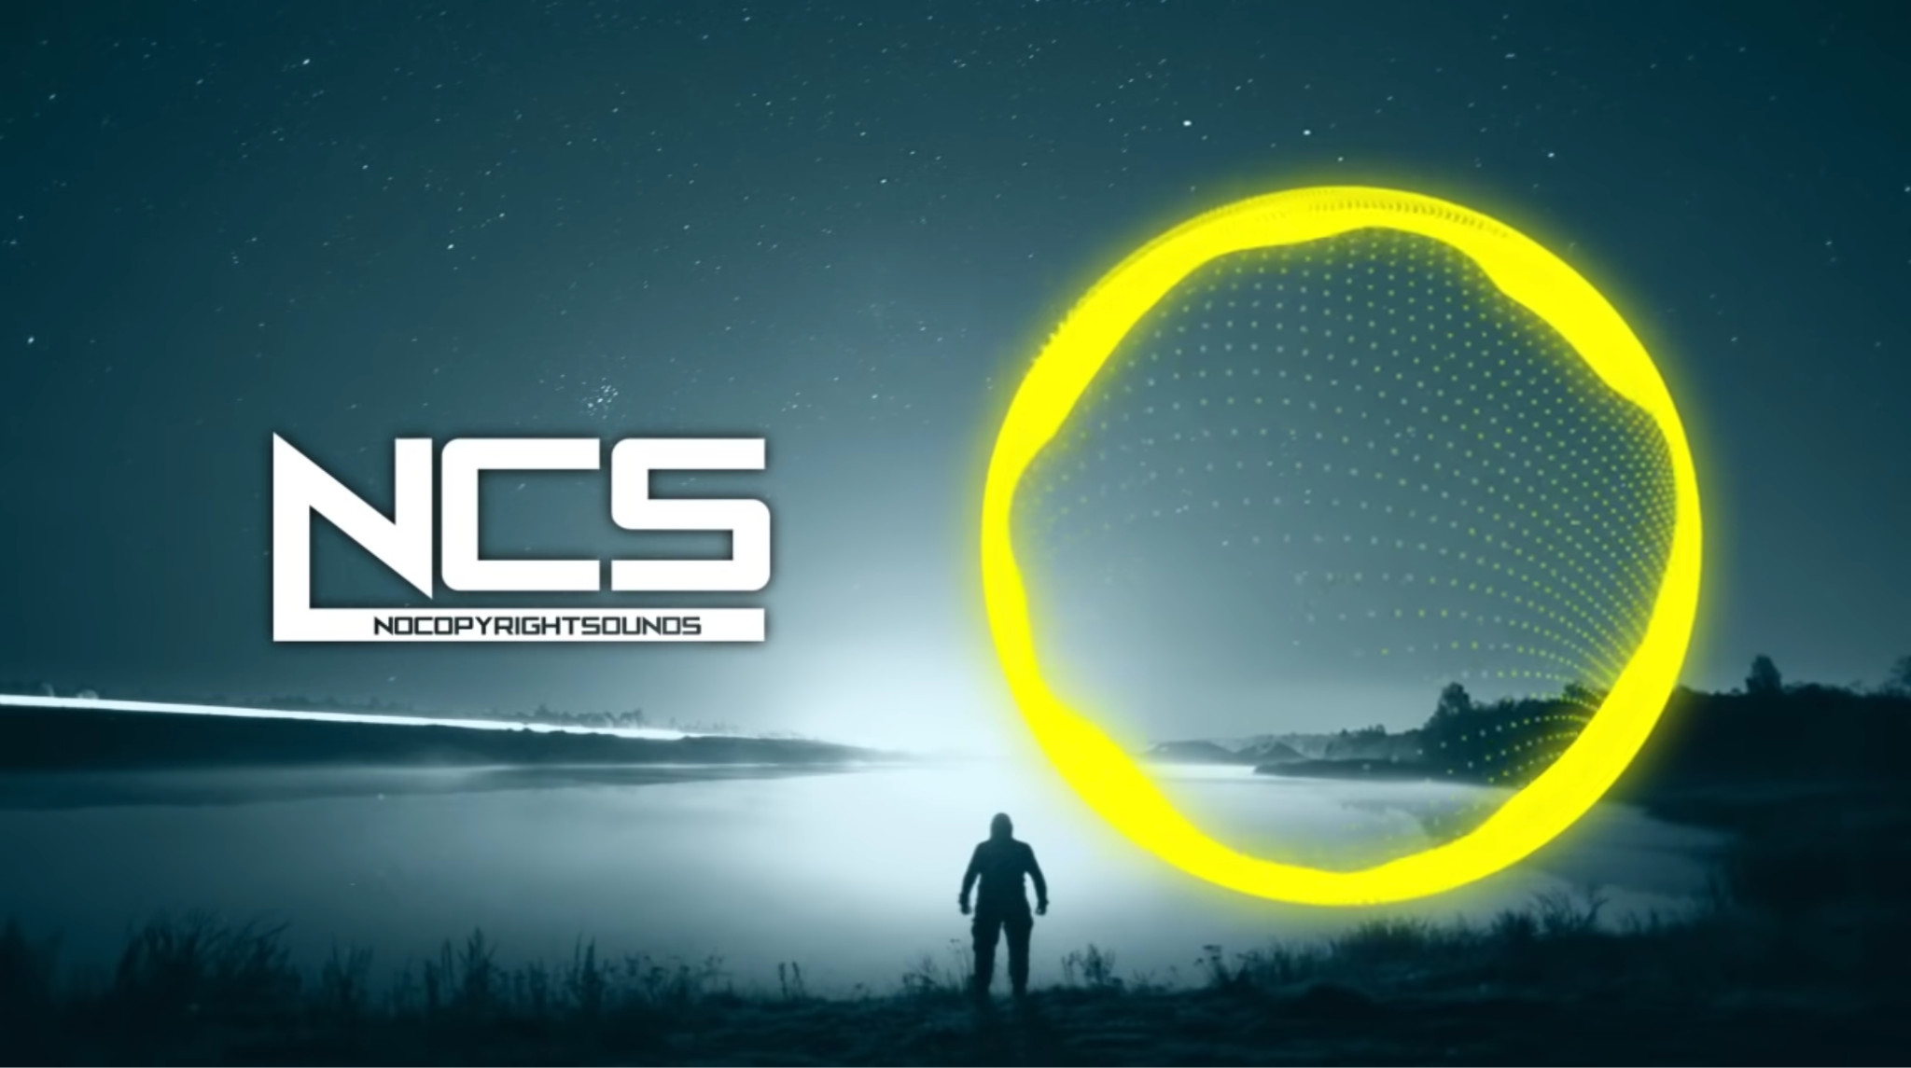
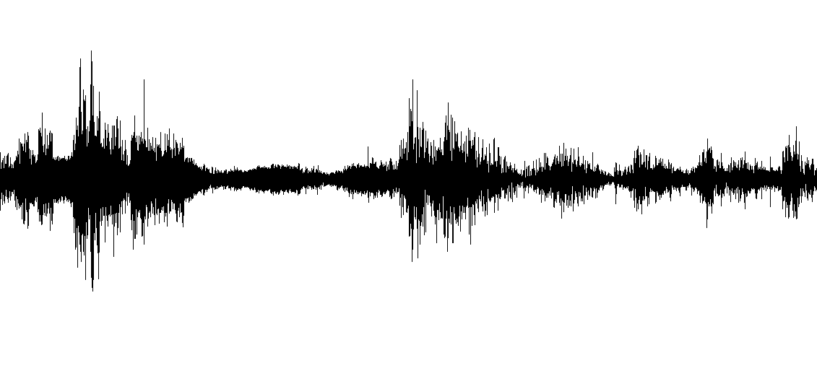
Generate spectrograms
Notes:
We found the most optimal format to represent the song audio to be 2D images of spectrograms. So, using the scraped song data, our program downloads the song audio from the links in the descriptions of the NCS videos. Then, the program reads in the audio samples
[Click for Slide Animation]
And makes them all a 240-second uniform length. Finally, we convert the audio to a Mel-spectrogram
[Click for Slide Animation]
The x axis is time, the y axis is frequency, and color is in decibels where brighter is louder.

Slide 9
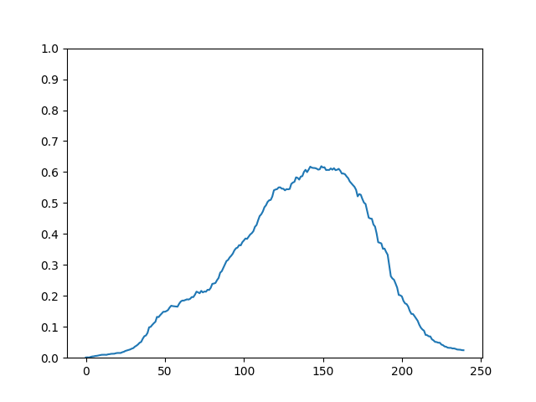
Model prediction
Notes:
The spectrogram is then passed to the model, which processes it and makes a prediction.
[Click for Slide Animation]

Slide 10
Model prediction
Notes:
It predicts 240 values, each for a 1s segment of the original audio, that denote the probability that it is in the best part of the song. Using a threshold of 0.5
[Click for Slide Animation]
And using the peak
[Click for Slide Animation]
The program determines the best interval of the song to use.
[Click for Slide Animation]
[Click for Slide Animation]

Slide 11
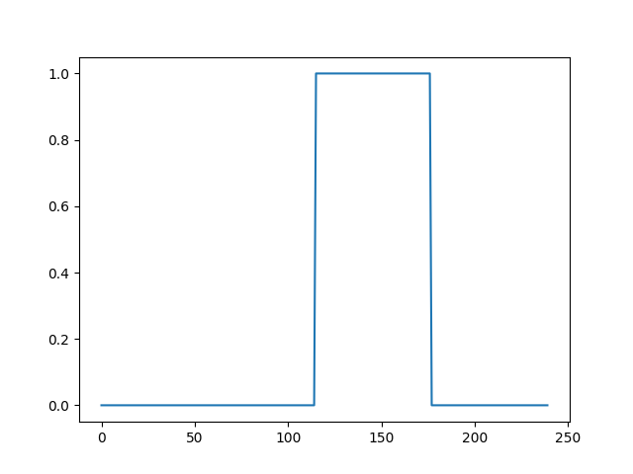
Model prediction
Notes:
In this example,
[Click for Slide Animation]
This is the best interval of the song

Slide 12
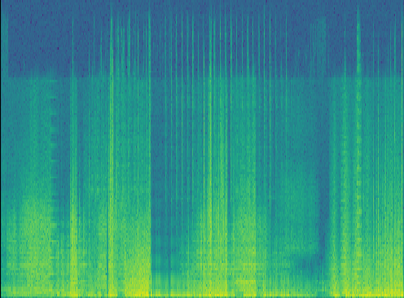
Spectrograms
20000 -
17500 -
15000 -
12500 -
f [Hz]
10000 -
7500 -
5000 -
2500 -
0 -
100 200 300 400 500
t [sec]
Notes:
Our program then converts the best part of the song into a regular spectrogram to extract descriptors for the song.

Slide 13
Cosine similarity
Notes:
The program then measures the similarity of each song using cosine similarity, which measures the angle between them. A computer represents the data as an array of numbers and we can envision each arrow, or vector, as the program’s representation of a song.
[Click for Animation]
As you can see, the pink and the purple song are very similar, while the yellow and pink songs are not very similar. Our program runs a cosine similarity on every song to find the smoothest songs to transition to.

Slide 14
Determining the best order
First song
NEXT SONG
REPEAT
Order complete
Find which song has the highest cosine similarity to the first song.
For all songs in playlist, use cosine similarity to find next unplayed song.
Pick a random song to play first using the random module.
The order has been determined. . . next transitions!
Notes:
To create the best mashup, the songs should be played in an order that enables smooth transitions between songs. To do this, first, a random song is chosen from the playlist to be the first song.
[Click for Slide Animation]
The next song is chosen by finding the song with the highest cosine similarity to the first song.
[Click for Slide Animation]
This process is repeated for all songs in the playlist while ensuring that the song chosen to go next isn’t already part of the mashup.
[Click for Slide Animation]
Next, we add transitions.

Slide 15
Adding transitions between songs
Fade in
crossfade
Fade out
Apply a 4 second fade in to the first song in the mashup.
Apply 2 second crossfades between songs.
Apply a 4 second fade out to the last song in the mashup.
Notes:
We applied 3 transitions to the mashup to improve its quality. We added a 4 second fade-in to the very first song in the mashup, 2 second crossfades between all consecutive songs, and a 4 second fade-out from the last song in the mashup.

Slide 16
Final product
Pause and unpause the mashup whenever you want!
Replay the music!
Skip to other parts of the mashup!
Check how far you are in the mashup!
Notes:
Once the mashup is created, the user can play it using the play button on the GUI.
[Click for Animation]
There are also pause and restart buttons
[Click for Animation]
as well as a slider that allows users to move to other parts of the mix.
[Click for Animation]
Additionally, there is a time bar on the bottom that tells the user how long the mashup is and how far they’ve gotten in the mashup.

Slide 17

Notes:
So without further ado, here is a demo of Cog*Ify
Click to play demo (1:20)

Slide 18
training pipeline
How was the model made?
Notes:
Now we’ll get into our training pipeline, specifically how the model was made.

Slide 19
Training pipeline
Create dataset
Generate spectrograms
Extract best time stamps
Train model
Notes:
We’ll first cover the dataset, then the spectrograms, extracting timestamps, and finally training

Slide 20
Training pipeline
Create dataset
Generate spectrograms
Extract best time stamps
Train model
Notes:
The first step in our training pipeline was building our dataset.

Slide 21



Create Dataset
Notes:
One major difficulty in our project was finding a dataset. We just couldn’t find a dataset large enough for the scope of our project.
[Click for Animation]
So, we decided to create our own. We used the YouTube API to scrape relevant data from the videos of several NCS music channels.
[Click for Animation]
From this data, we filtered the dataset to remove videos that weren’t songs, such as instructional videos, and those that were either duplicates, mashups or compilations.
[Click for Animation]

Slide 22
Training pipeline
Create dataset
Generate spectrograms
Extract best time stamps
Train model
Notes:
Next, we generate the spectrograms

Slide 23
Generate spectrograms
Notes:
Just as we did at deployment time, we download the no copyright audio
[Click for Animation]
Read it in as audio samples
[Click for Animation]
And convert it to spectrograms

Slide 24
Training pipeline
Create dataset
Generate spectrograms
Extract best time stamps
Train model
Notes:
Now it’s time to extract the best time stamps

Slide 25
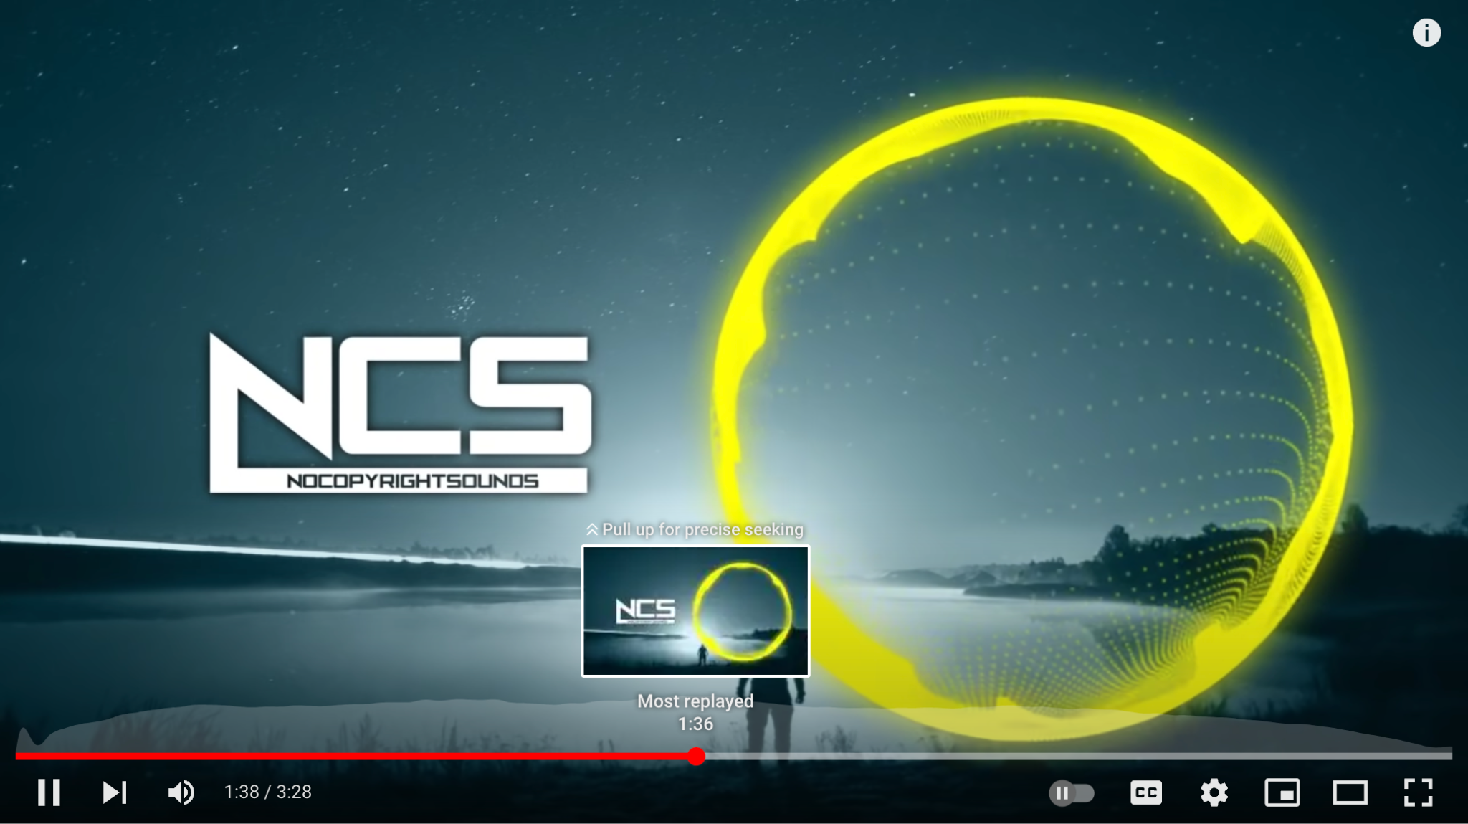
Extract best time stamps
Notes:
When playing a YouTube video you might have noticed that if you hover your mouse to scrub through the song, a replay graph appears.
[Click for Animation]
As humans we tend to replay our favorite parts of the song the most

Slide 26
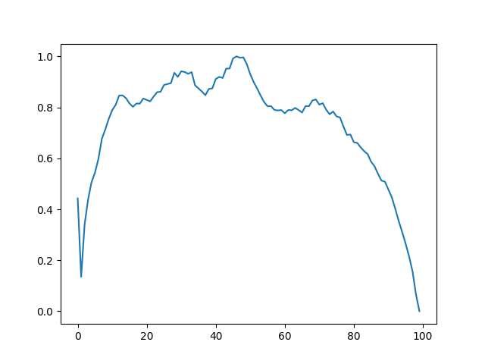
Extract best time stamps
Notes:
So, the program scrapes the replay graph from the video in form of 100 data points
[Click for Animation]

Slide 27
Extract best time stamps
Notes:
Which we process like we did for the model predictions at deployment time. Using a threshold of 0.8 here,
[Click for Animation]
And the peak,
[Click for Animation]
The program determines the best part of the song to use
[Click for Animation]
[Click for Animation]

Slide 28
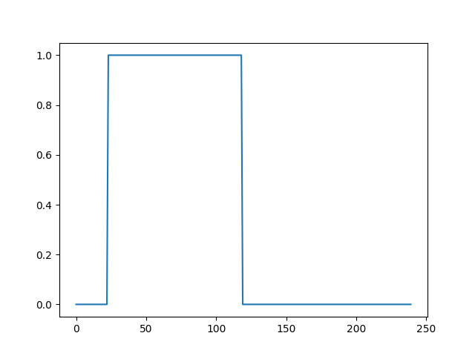
Extract best time stamps
Notes:
Then, the program scales the values to 0 or 1
[Click for Animation]
And correlates them with time stamps depending on the duration of the song. These 240 values, one for each second in four minutes of audio, are the labels associated with the spectrograms.

Slide 29
Training pipeline
Create dataset
Generate spectrograms
Extract best time stamps
Train model
Notes:
Finally, the actual training of the model

Slide 30
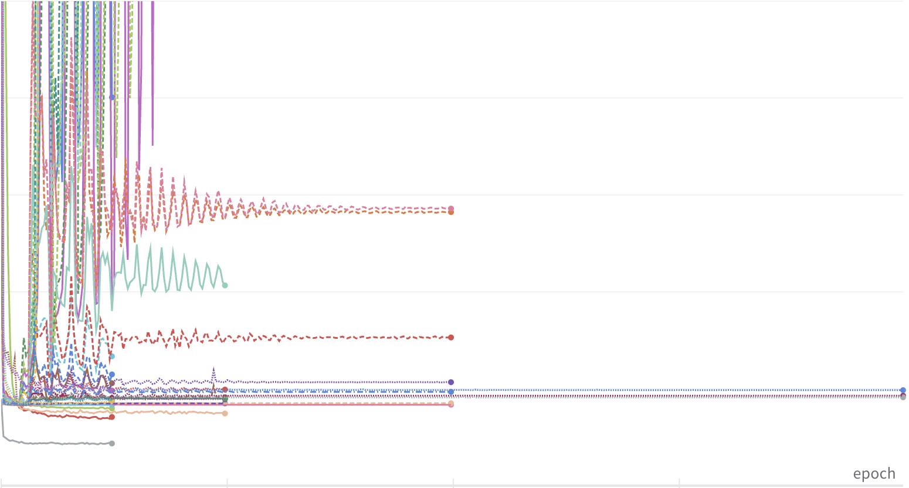
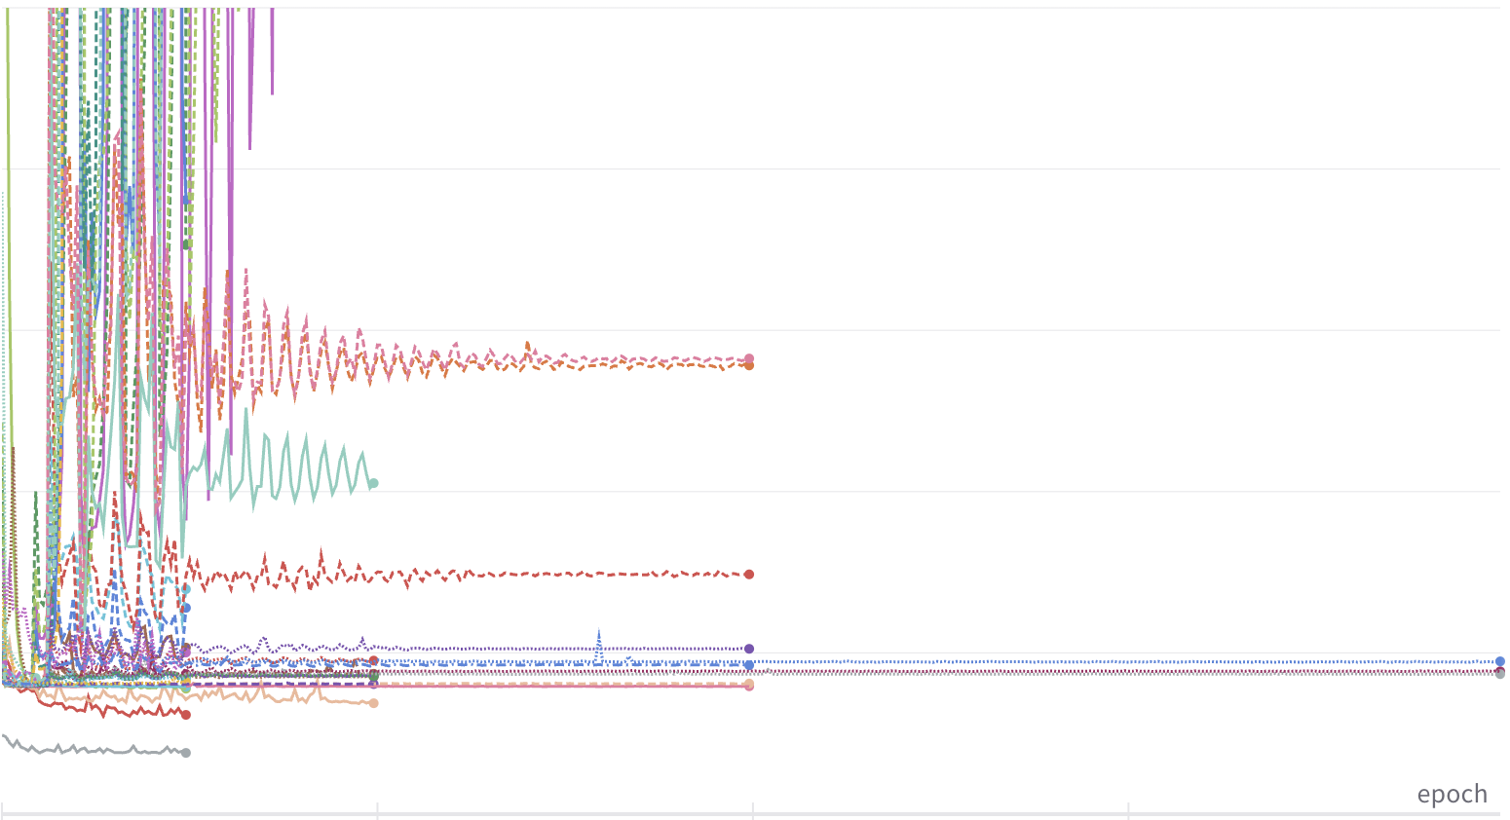
Hyperparameter optimization
Loss
Validation Loss
Epochs
Epochs
Notes:
Since the input is images, the best model for us is a convolutional neural network. However, being that our model is made from scratch, we still need to know how many layers, how many filters, kernel size, and other variables. So, we tested 50 configurations whose loss and validation loss graphs are visible here. We chose the configuration that yielded the lowest validation loss

Slide 31
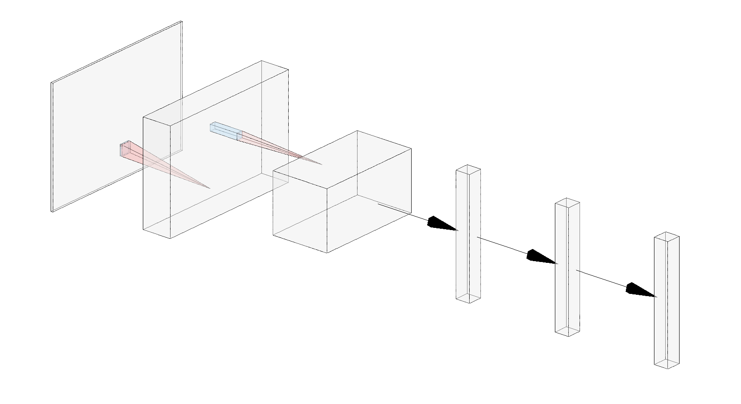
Model architecture & Hyperparameters
2813
1407
Dense Layers
256
176
128
16
1
4
16
Convolutional Layers
256
256
240
Notes:
The best configuration was firstly three convolutional layers.
[Click for Animation]
The first with 4 5x5 filters, the next with 16 3x3 filters, and finally 64 3x3 filters. Now transitioning to the 1D space the layer is flattened and then fed into three dense layers.
[Click for Animation]
The first and second with 256 nodes and the last one with 240 nodes for 240 seconds in four minutes. The model was trained for 50 epochs.

Slide 32
Music video generation
Notes:
Using the generated mashup of songs, the user can also create a music video with a simple press of a button!

Slide 33
Automated Music Video generation
Diffuse
Interpolate
Synchronize
Play
Input prompt to HuggingFace’s Stable Diffusion to generate images
Gradually move from vector of one image to another for smooth transition
Match the image frames to beats of music using spectrogram analysis
Utilize PyGame to play audio with images and save video
Notes:
First, a Stable Diffusion model generates images based on inputted prompts. Then, intermediate frames are created using image interpolation to transition between images. Next, the images are synchronized with the audio file. Finally, the music video is downloaded and played.

Slide 34
Notes:
Here’s a sample of the music video generator! The prompts given to the diffusion model were “abstract geometry” and “cosmic landscape.”
Click to play demo (1:20)

Slide 35
FUTURE IMPROVEMENts
Music Video GUI
Own playlist
Improve accuracy
Integrate music video generator into GUI & create prompts based on song lyrics
User identifies genre and preferences -> program creates new playlist
More memory and higher resolution spectrograms
Notes:
In the future, we want to integrate the music video generator into the GUI. Additionally, given a music genre, the program should recommend its own playlist to mashup using a song database. And finally, improving the accuracy of our model by using a computer with more memory for higher resolution spectrograms.

Slide 36
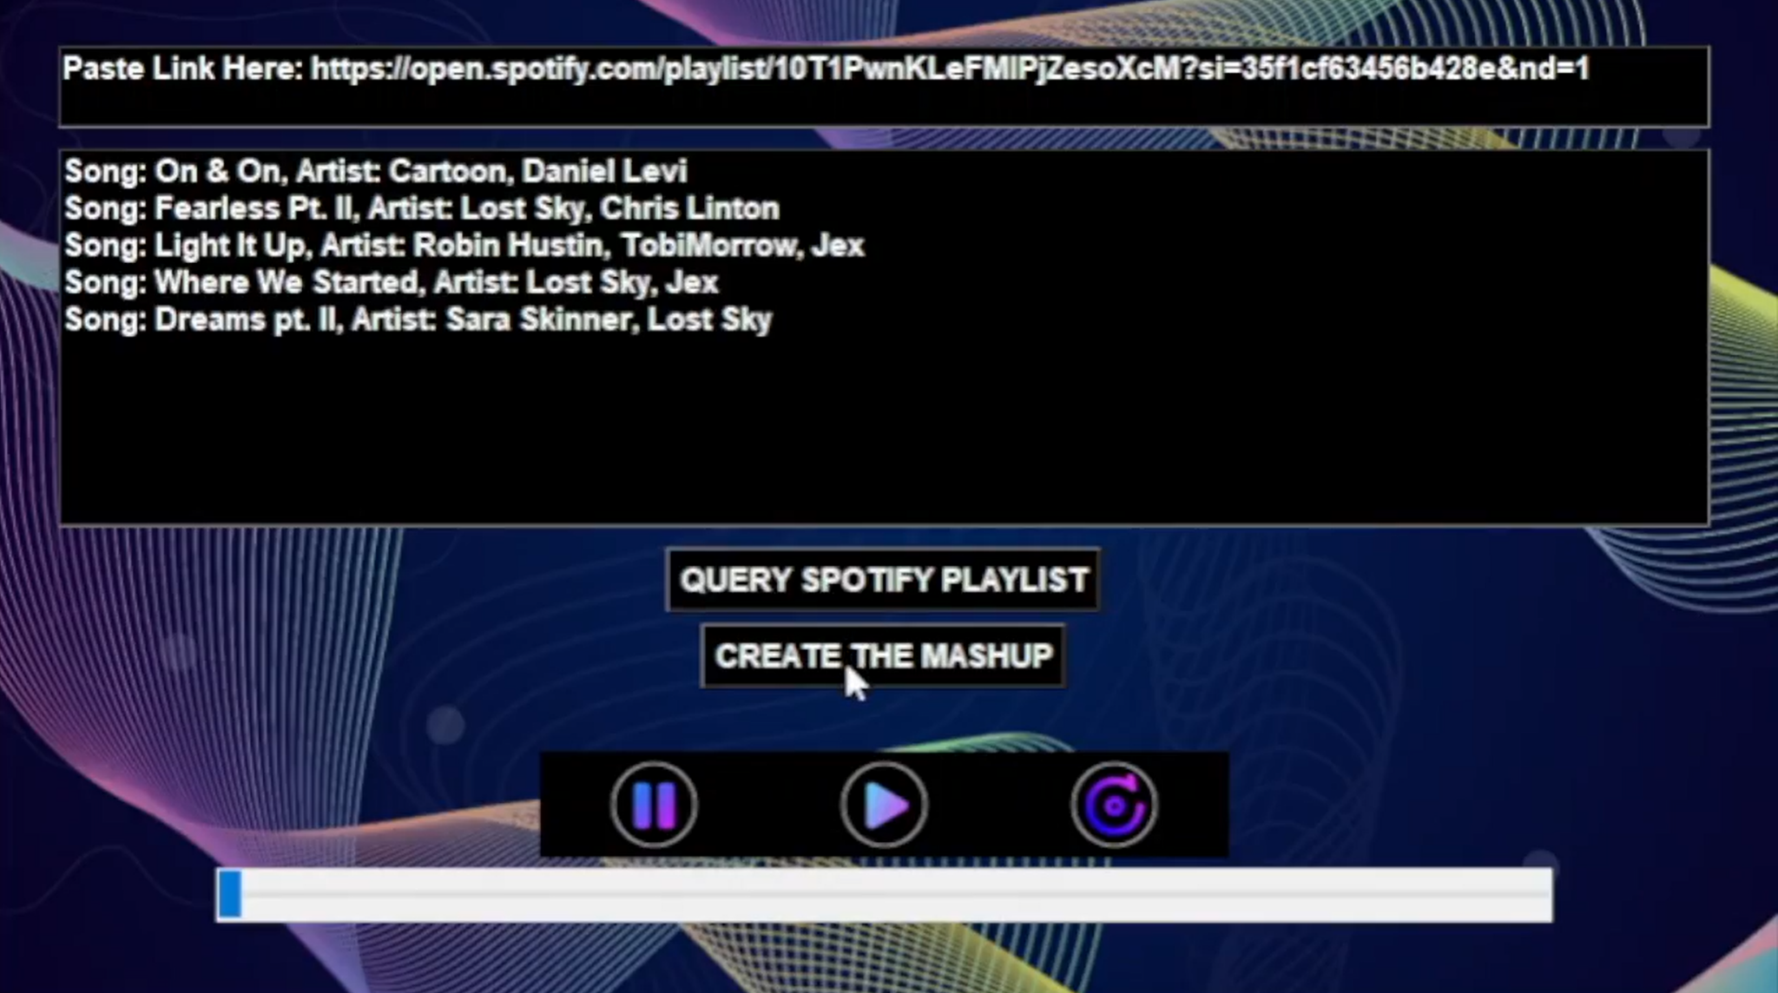

Recap
Problem: Playing music without a DJ
Solution: Automated DJ With Cog*Ify
Generated Spectrogram
Extracted timestamps
Trained CNN
Deployed gui
Created music video
Notes:
To recap, we covered the problem of not having a DJ which we solved by automating the DJ with Cog*Ify!
[Click for Animation]
To do this, we generated spectrograms, extracted the timestamps from songs from a Spotify playlist, and trained a model to predict the best parts, before mashing them.
[Click for Animation]
Then we deployed this functionality in a user interface and also created a music video generator to play with the song mashup.
Thank you so much to all the instructors and TAs for guiding us throughout this project, and to everyone here for listening! We’re happy to take any questions on our project.

